Slide 1
Polit2 behavior analysis (P=6)

Slide 2
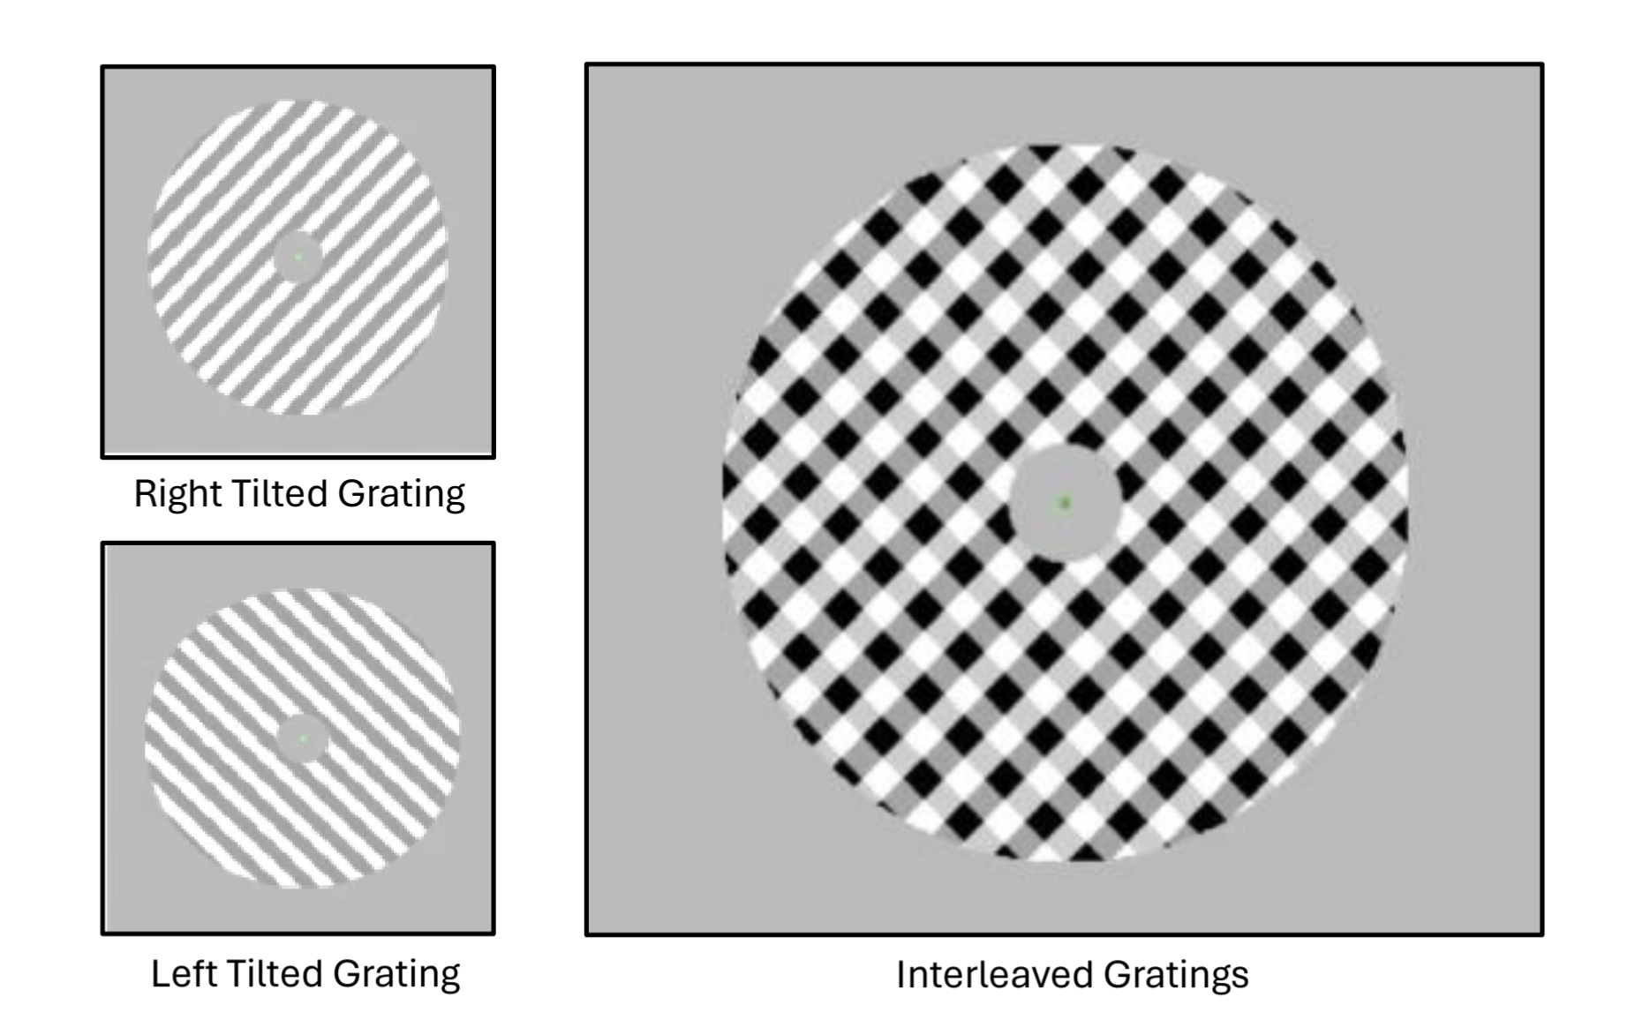
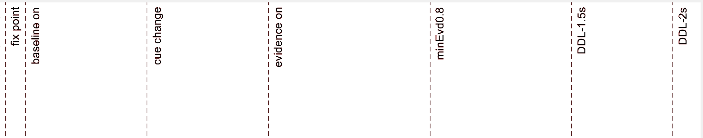
Change made in exp (delay feedback training before each block)
2 coherence level – easy (0.1) and hard (0.05)
Change made in position (from p4)
SSVEP why 18.75?
EVon
0.8s – 3s
RT
0.2s – 1.8s
0.2s
EVoff
0.1s
0.6s
0.6s
0.8s
1s
1.2s

Slide 3
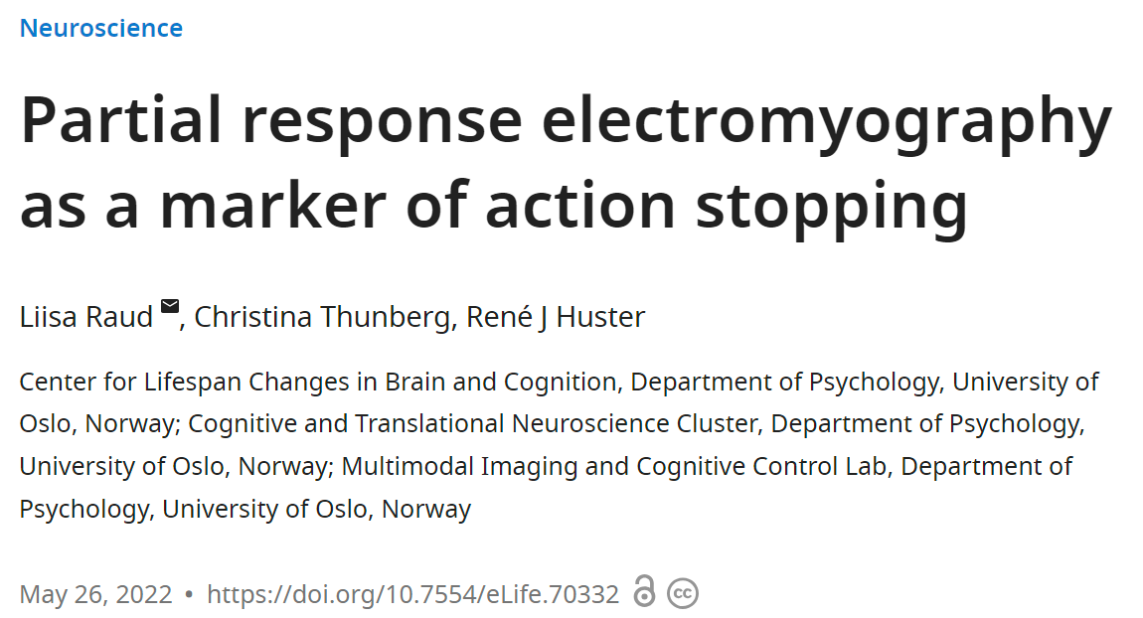
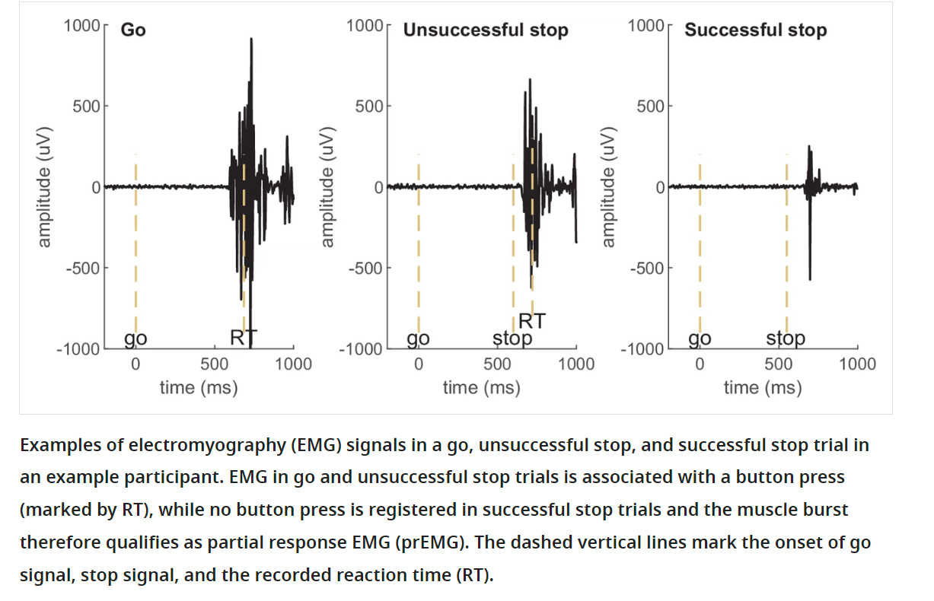
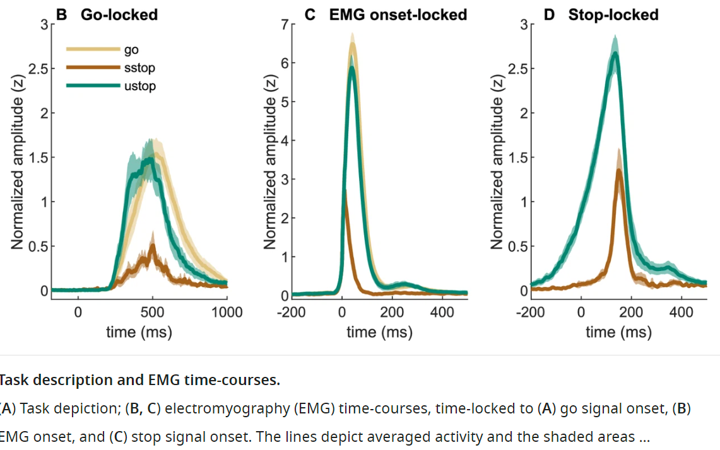

Slide 4
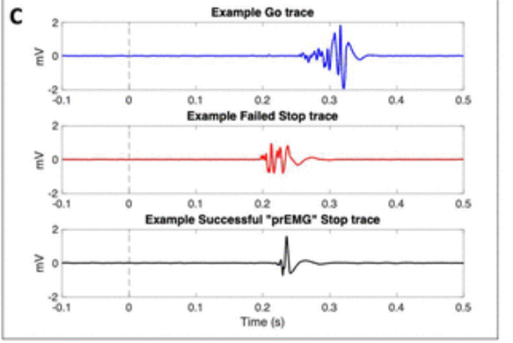

prEMG != partial bursts/errors

Slide 5
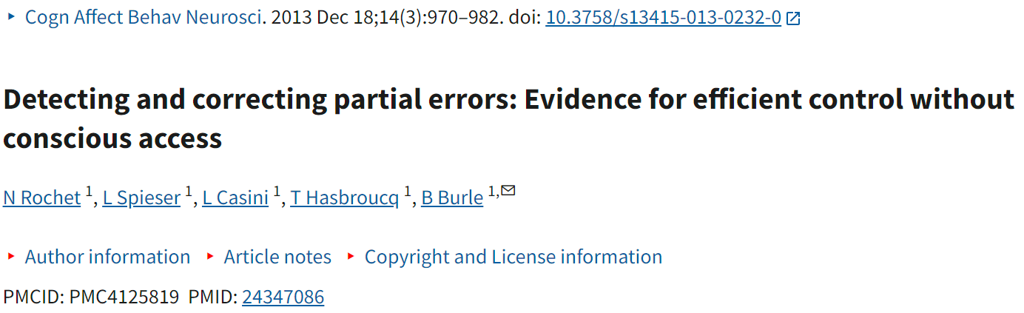
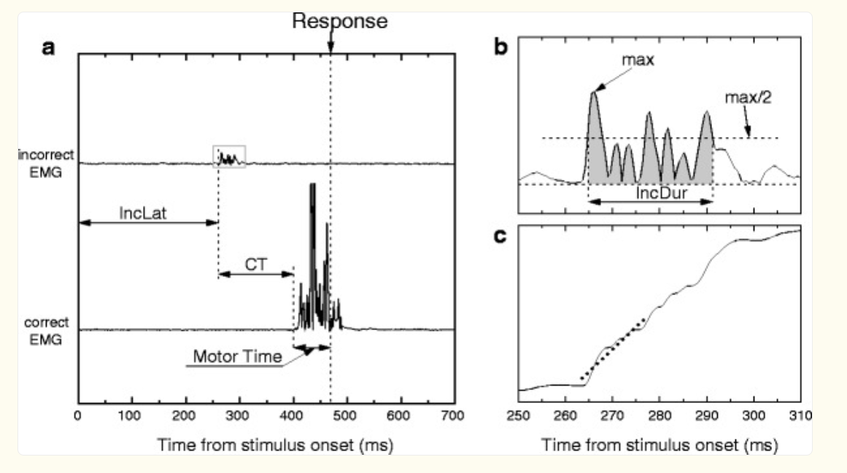
n the present study, we showed that, unlike overt errors, such “partial errors” are poorly consciously detected by participants, who could report only one third of their partial errors.

Slide 6
EMG Partial Burst
a localized, transient increase in muscle activation detected as a brief burst of electrical activity in an electromyogram (EMG) signal.
Pre-motor activity: Neural preparation for movement.
Feedback corrections: Adjustments to motor output.
Partial recruitment of motor units: Subset of muscle fibers activated.

Slide 7
Findings:
Accuracy increase after learning
Rt decrease after learning
Partial burst decrease after learning

Slide 8
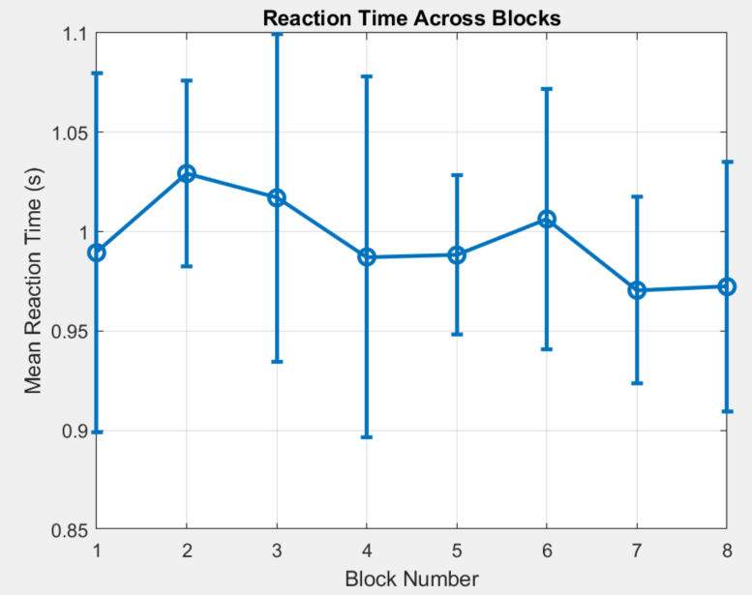
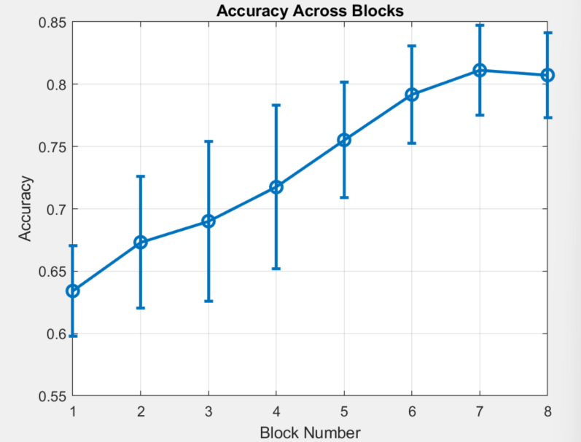
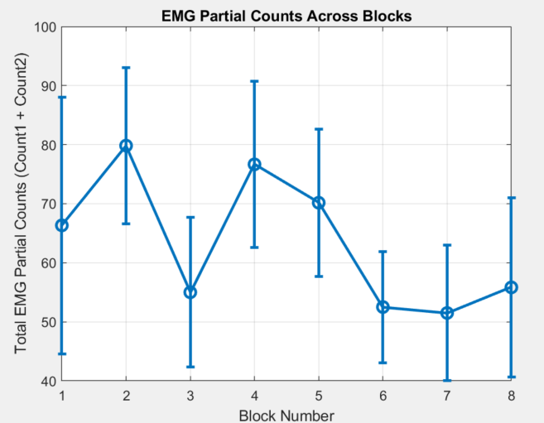
SubID Acc RT EMGOnsite CountL1 CountL2
1.0000 0.6562 0.9416 0.8582 134.0000 233.0000
2.0000 0.7852 1.0831 1.0097 101.0000 54.0000
3.0000 0.7412 1.0258 0.9011 143.0000 67.0000
4.0000 0.5654 0.7905 0.6876 76.0000 188.0000
5.0000 0.8301 1.0459 0.9613 205.0000 150.0000
6.0000 0.8320 1.0855 0.9281 181.0000 82.0000

Slide 9
Findings:
H has higher acc and low rt
Partial bursts is more in L
The first partial burst happening time for H is early
And the trend of the time first partial burst decrease

Slide 10
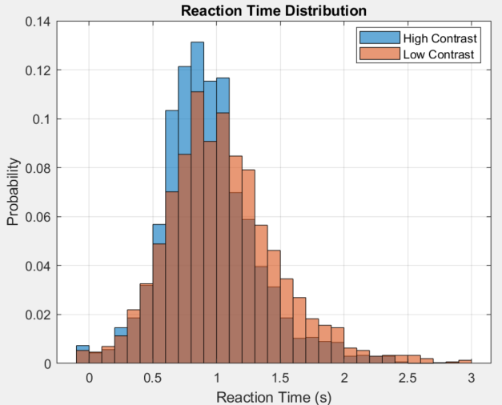
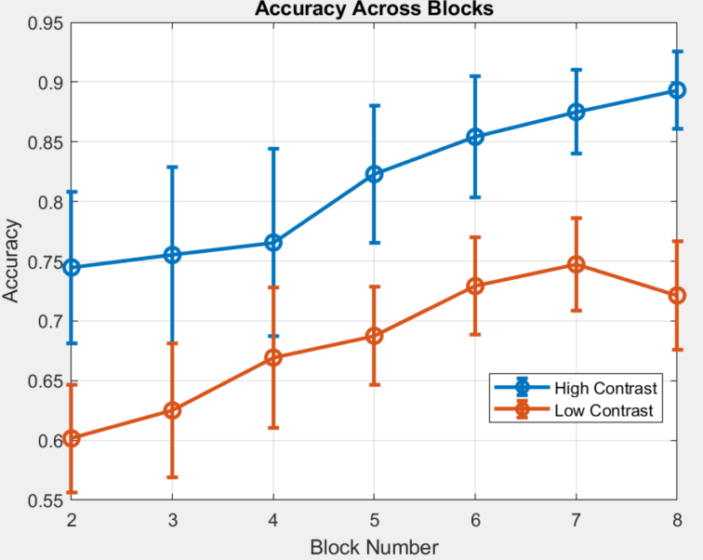
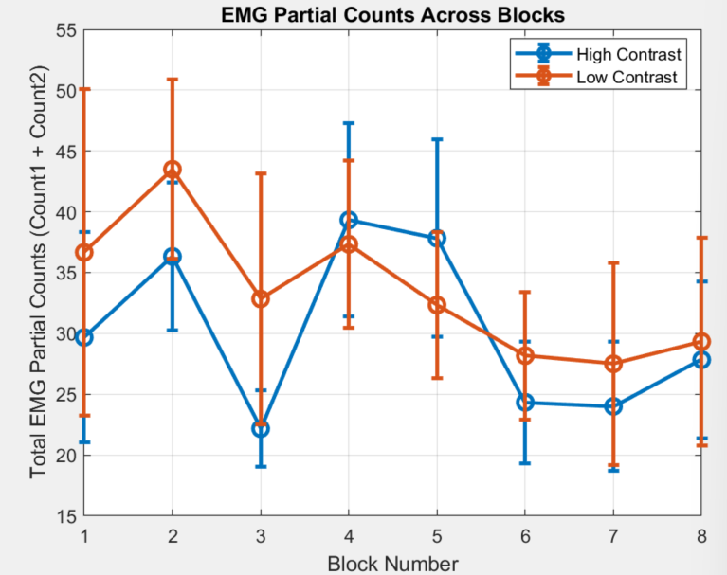
H vs L

Slide 11
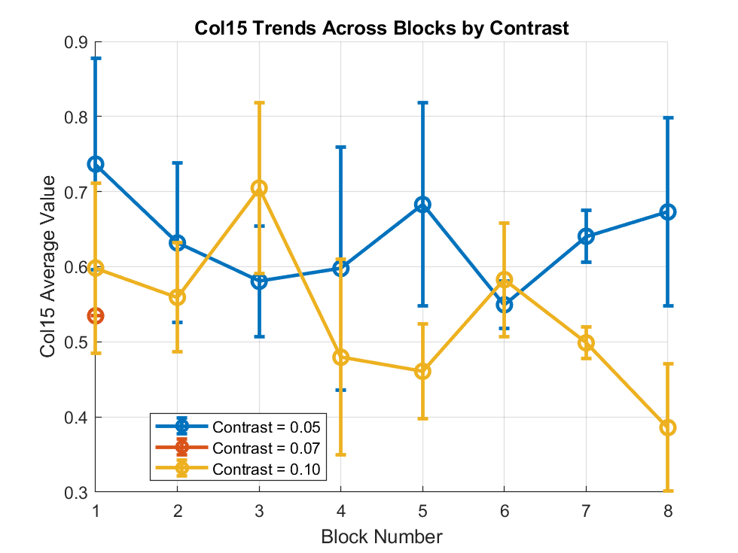
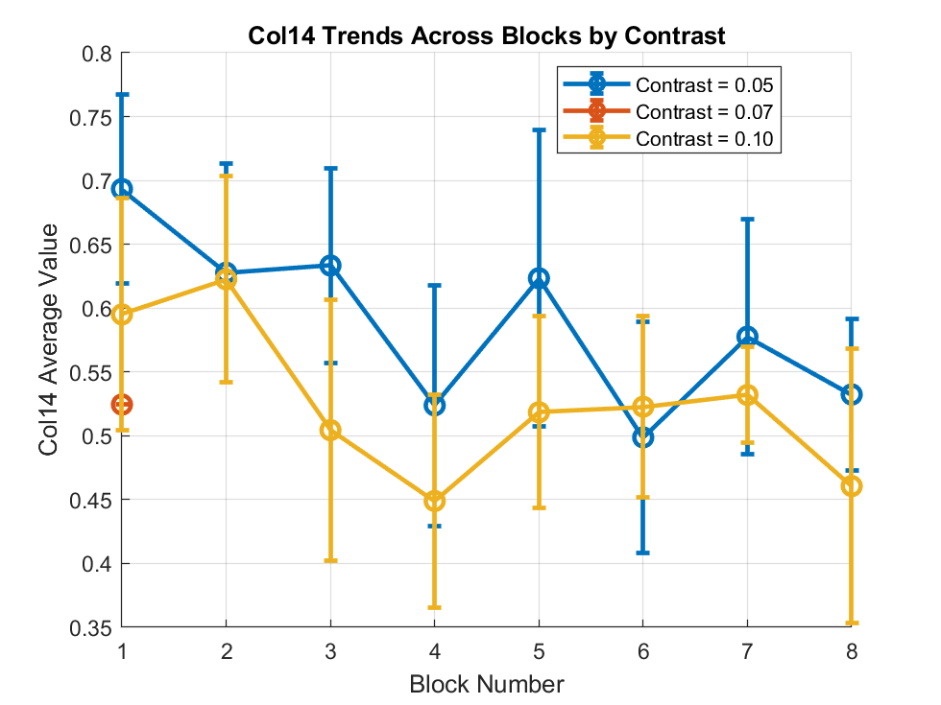

Slide 12
Findings:
FDI rt faster
BCP no partial bursts
FDI learning more
Rt change less between trials

Slide 13
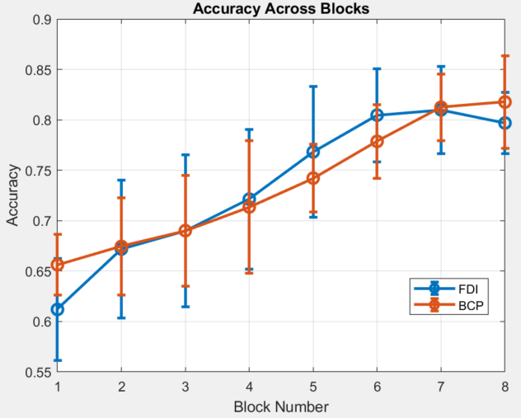
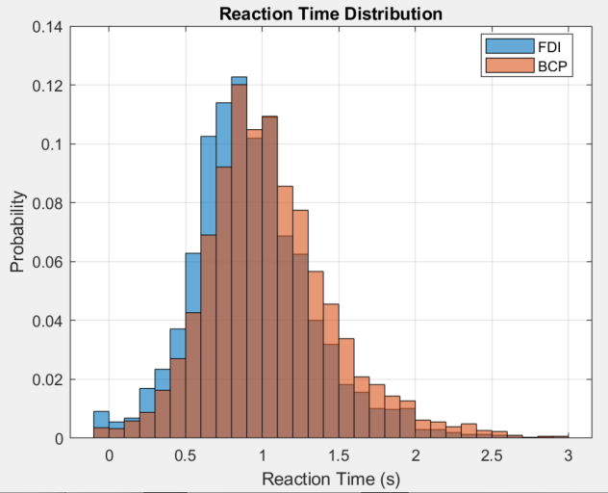
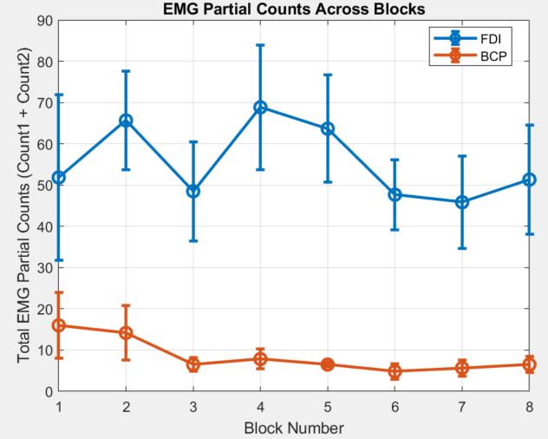
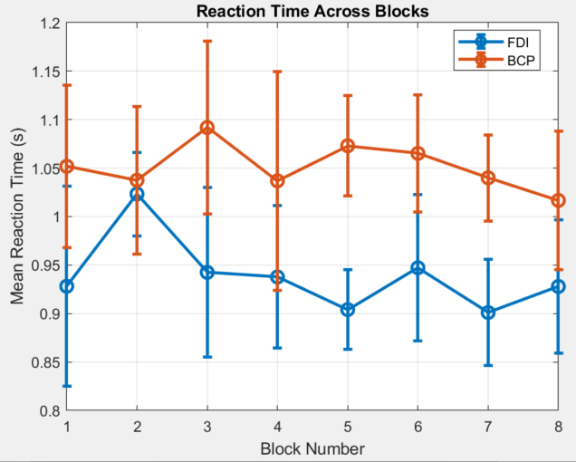

Slide 14
Learning happens in MT (or a little in FDI decision time)
FDI is faster in decision time (Emg onsite)
BCP is faster in MT (RT-EMGonsite)

Slide 15
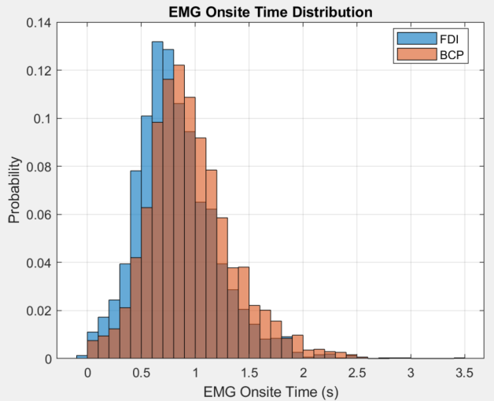
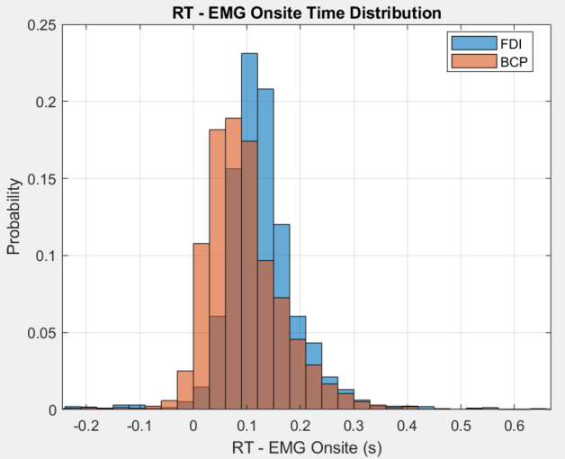
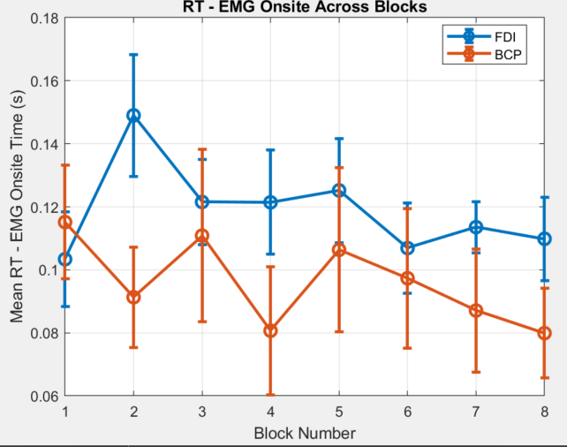
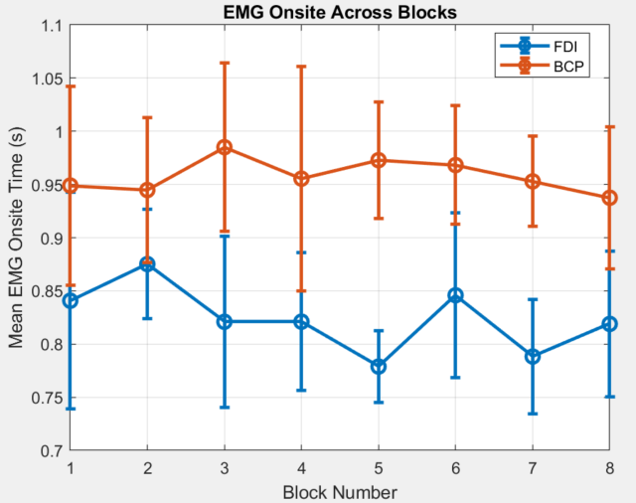

Slide 16
Dominate hand makes diff:
Left is slower

Slide 17
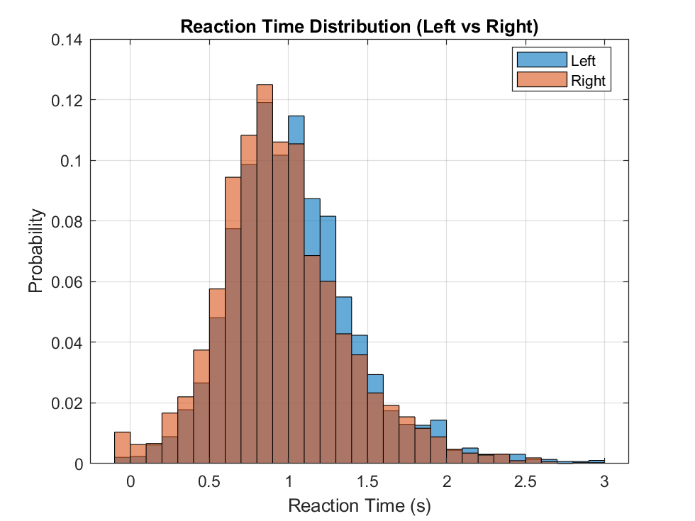
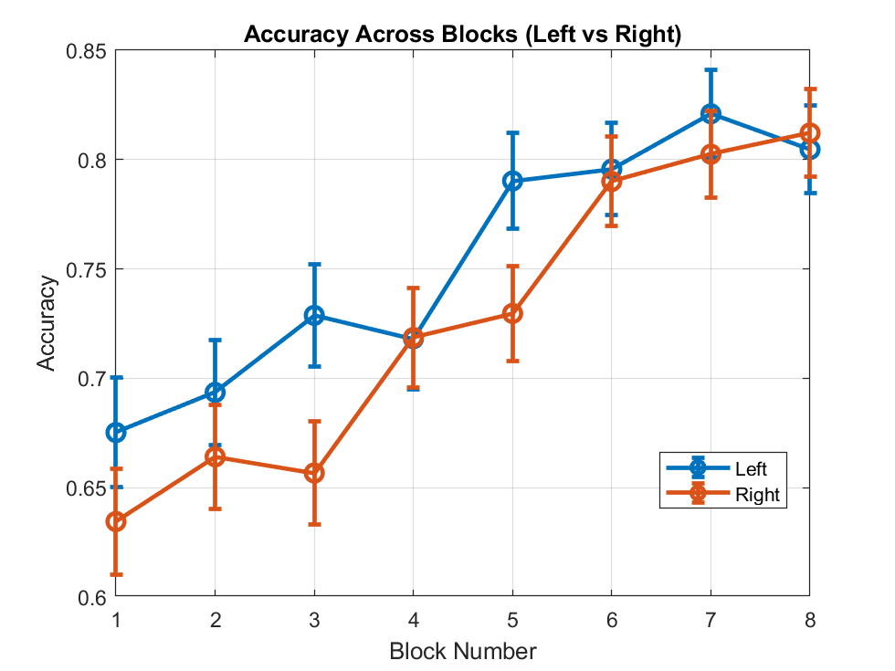
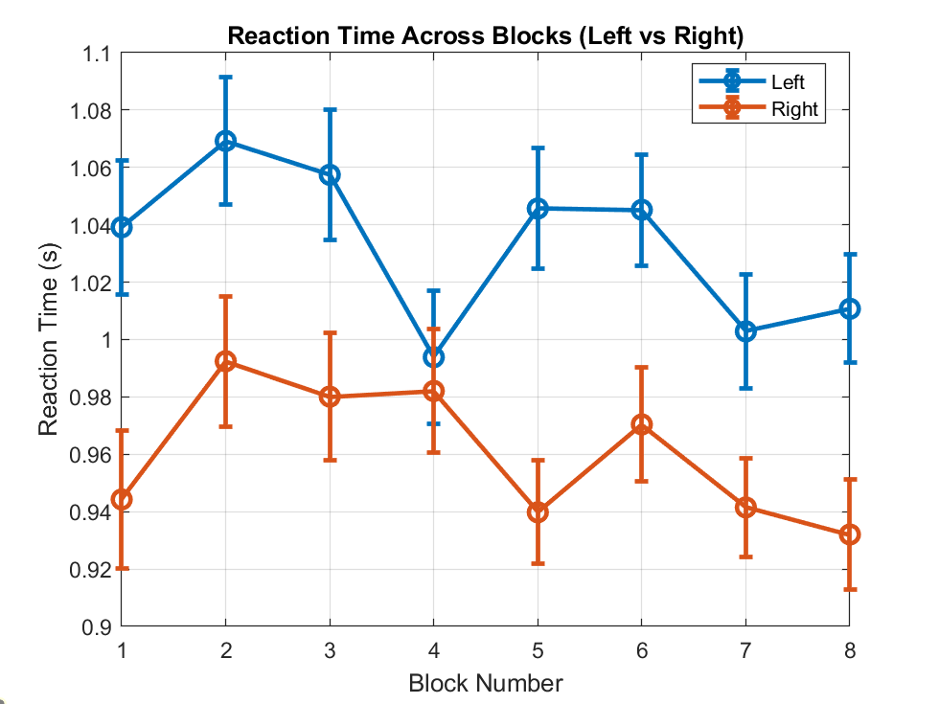
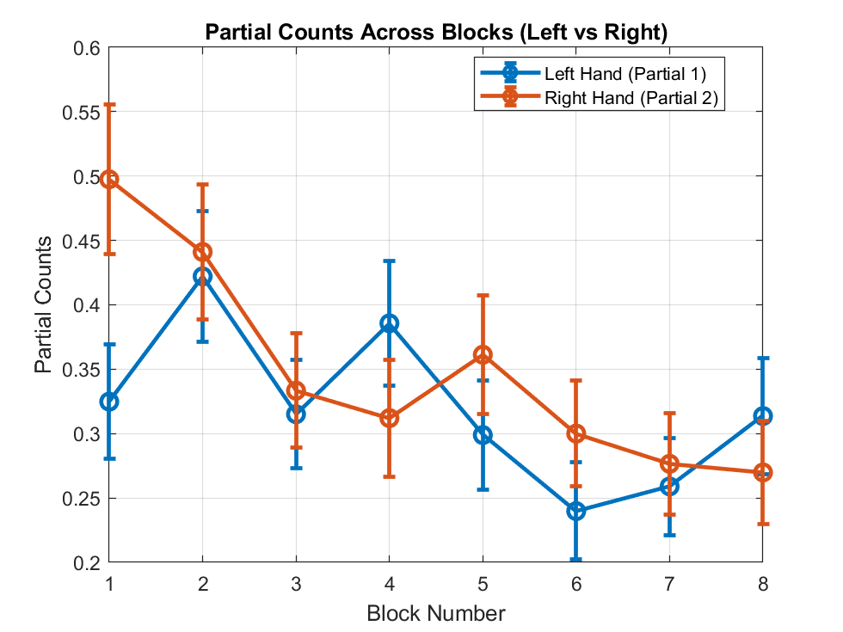

Slide 18
Left is slower in both MT and EMGonsite

Slide 19
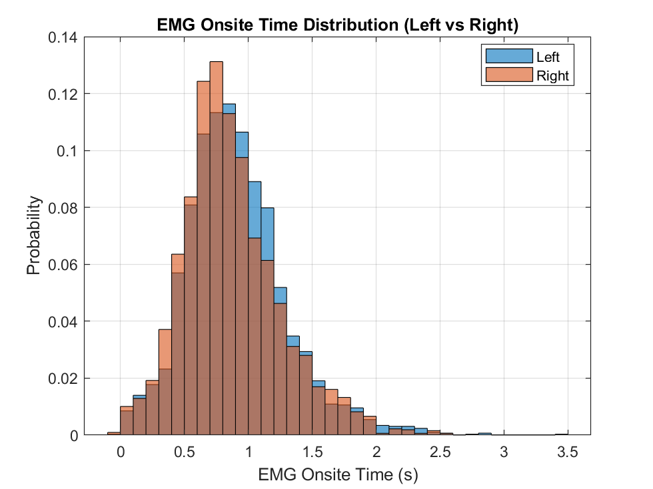
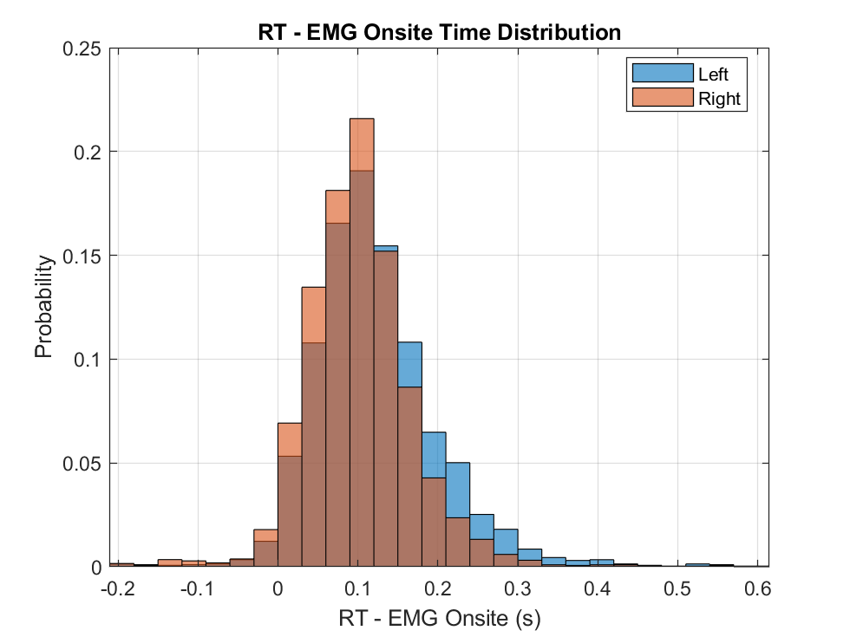
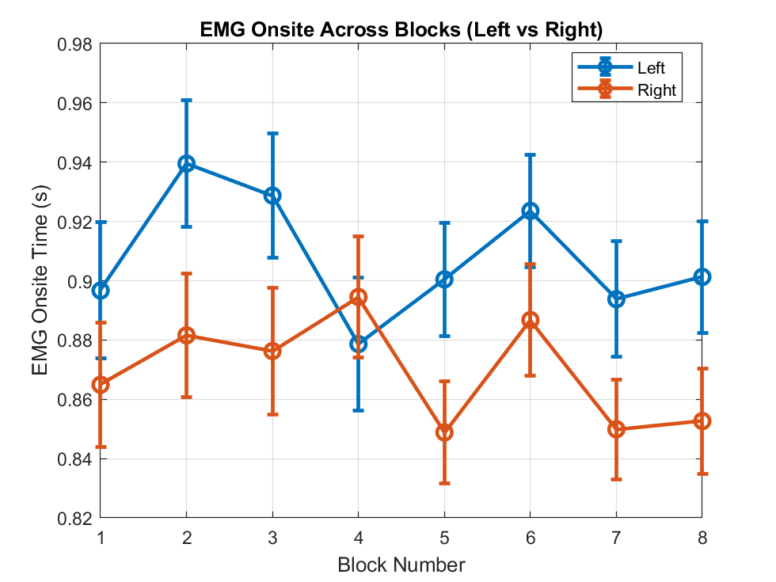
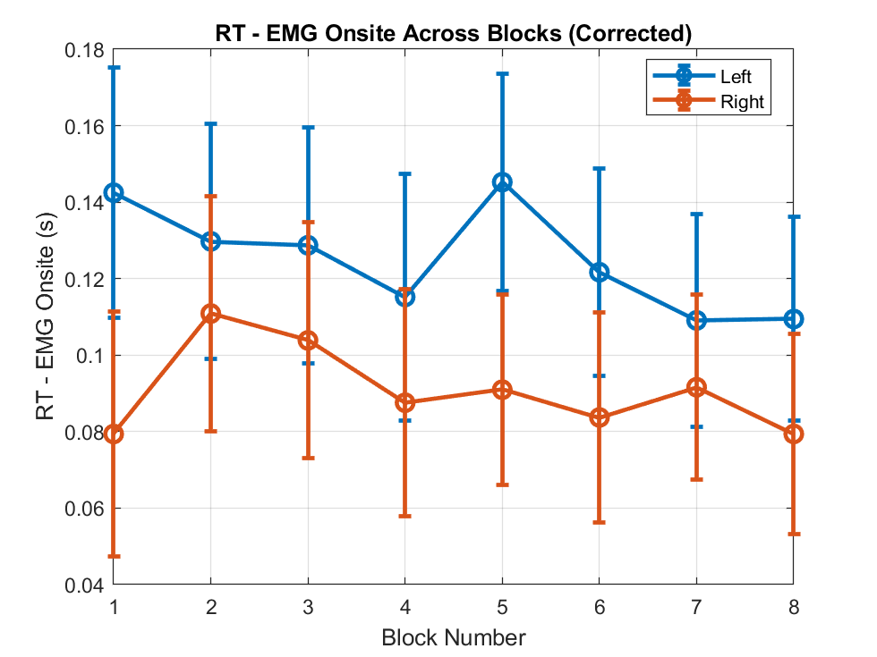

Slide 20
